Slide 1


7 Principles of Economic Thinking
Your Guide to Thinking Like an Economist

Slide 2

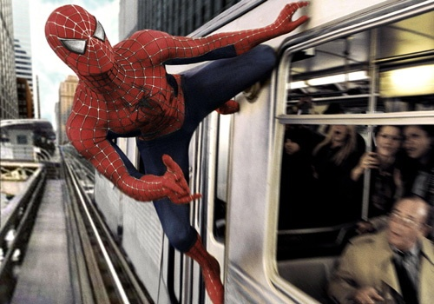

#1- Scarcity Forces Tradeoffs
Because all resources are limited, we are forced to make decisions.

Slide 3
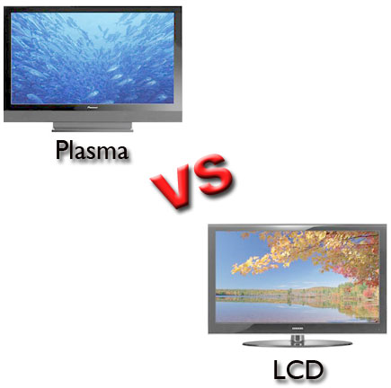

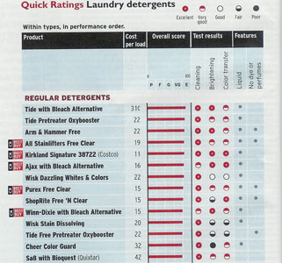
#2- Cost Versus Benefits
People makes decisions when the benefits of those decisions outweigh the costs.

Slide 4
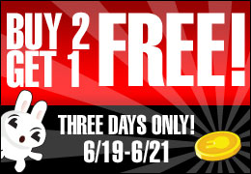

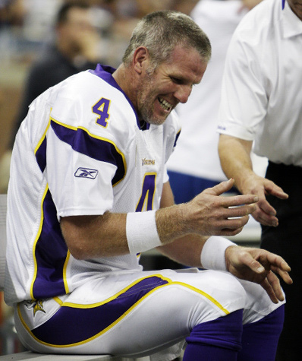

#3- Thinking at the Margin
Making a small change to what we already do.
One more hour please!

Slide 5
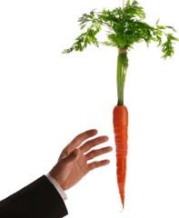



#4- Incentives Matter
People will do things if there is something in it for them.

Slide 6

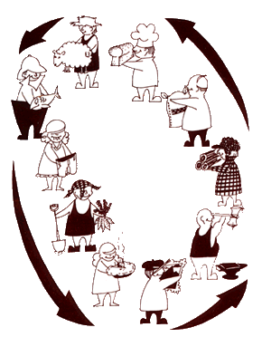
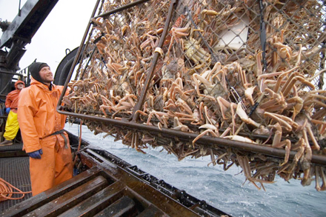
#5- Trade Makes People Better Off
When people focus on one thing, and trade it with others, we all benefit.

Slide 7
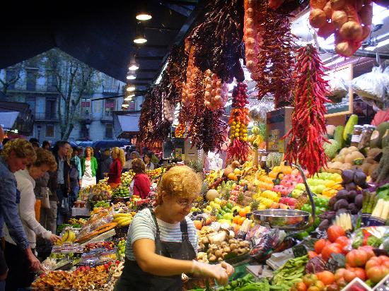

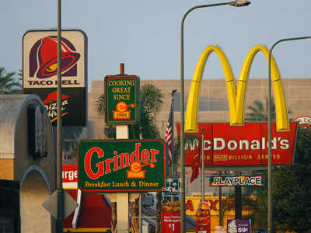
#6- Markets Coordinate Trade
Buyers and Sellers will find each other through the power of the free market.

Slide 8
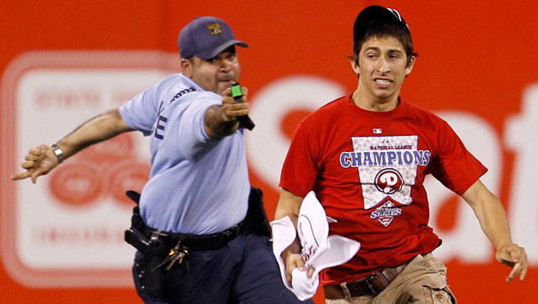
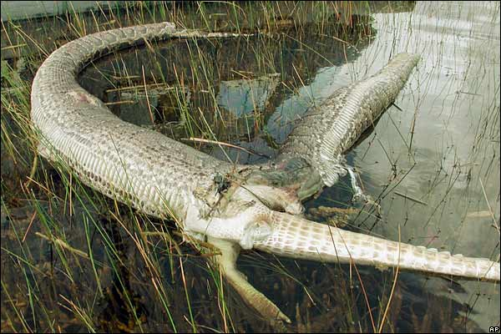

#7- Future Consequences Count
What we do today affects us not only today, but in the future as well.

