Slide 1


The Nature of Crimes
Chapter 7 Part 1

Slide 2
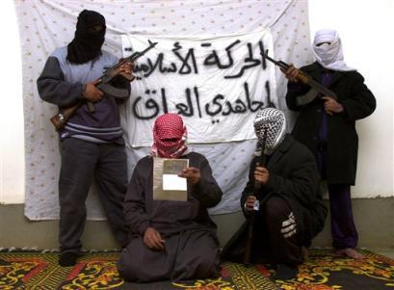


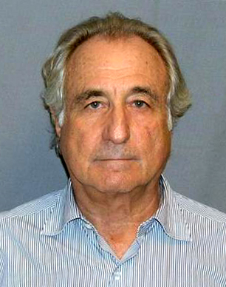
The Aspects of Crime
There are a wide variety of crimes committed by all types of people

Slide 3
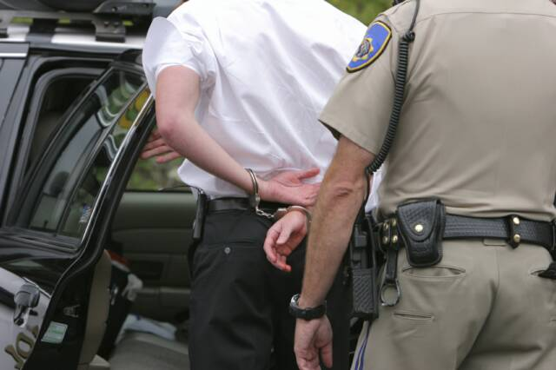



What is Crime?
Something one does or fails to do that is a violation of the law
Has been a major problem in the U.S.
  Federal
  State
  Local

Slide 4
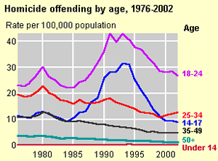
How Bad is Crime Today?
Believe it or not, reported crime has decreased since the 1980s

Slide 5
What Causes Crime?
Poverty
Unemployment
Lack of education
Alcohol/Drug Abuse
Lack of parental involvement
The media
Others?

Slide 6

What can be done to further decrease crime?
Incarceration (Imprisonment)
  Already highest of all industrialized countries
More police officers
Community Policing: community actively works with the police

Slide 7
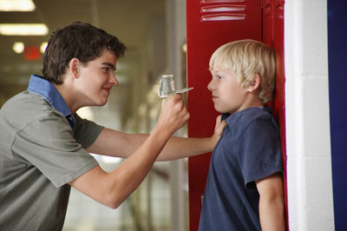

Crime at School
Schools are generally seen as a safe place, but…
  For every 100 students, there were 3 instances of violent crime (2006)
  Middle School Students is twice as high

Slide 8

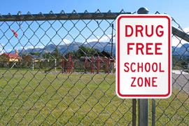
Drugs at School
75% of schools larger than 1,000 students reported at least drug related incident

Slide 9
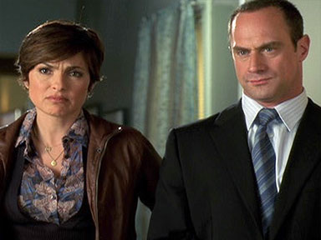
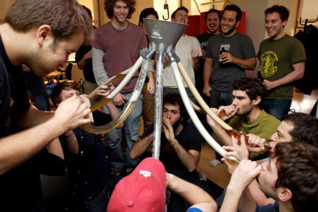
College and Crime
Alcohol Abuse is leading problem, which often leads to:
  Assaults
  Rape

Slide 10

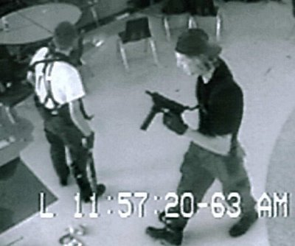

Campus Shootings
Virginia Tech (2007)
NIU (2008)
University of Texas (1966)
Columbine High School (1999)
Sandy Hook Elementary (2012)

