Slide 1
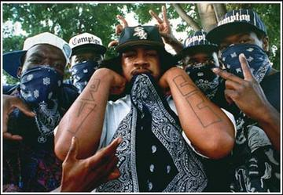
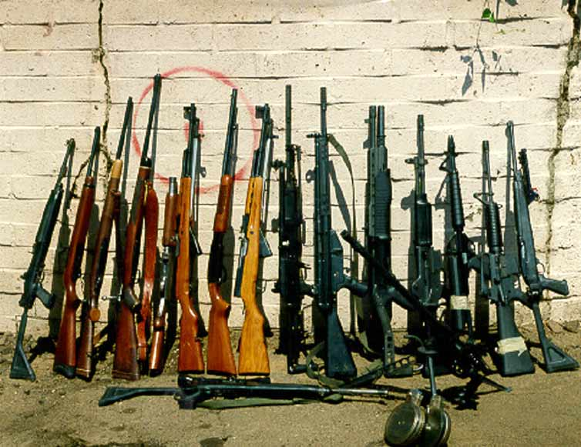
Gangs & Guns
Chapter 7 Part 2

Slide 2
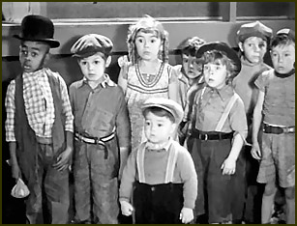
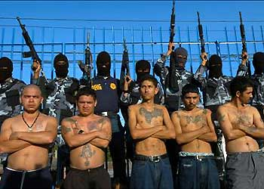
What is a “Gang”?
Defined as a group of people who deny the general public access
May or may not be violent

Slide 3
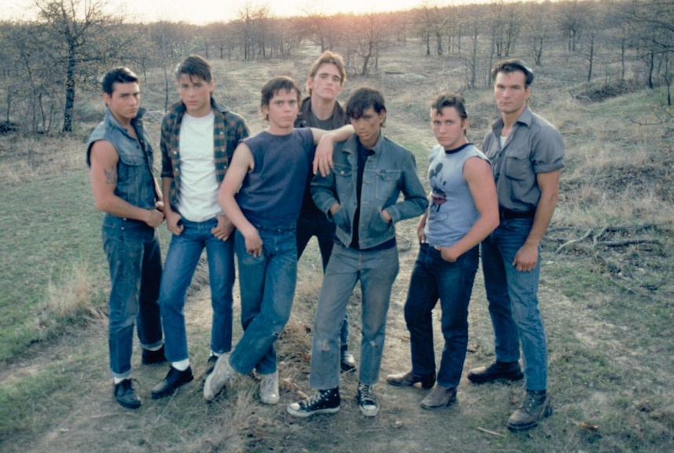
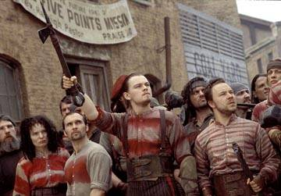
A Brief History of Gangs
Started in America in the 1800s, grouped by ethnicity
Usually protected neighborhoods and cultural pride

Slide 4
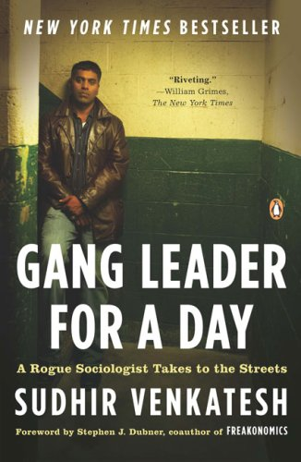
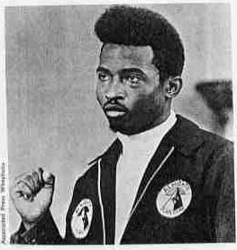
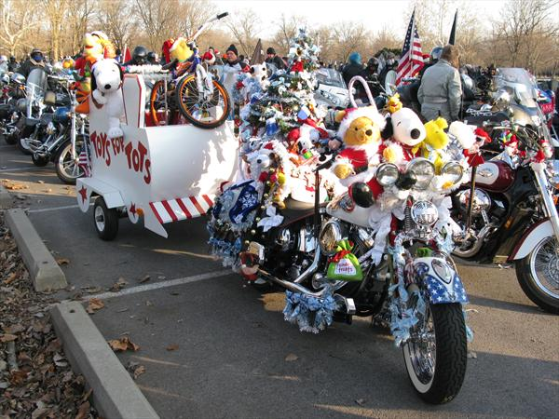
Trying to make a difference?
Many gangs performed community service & job-training

Slide 5
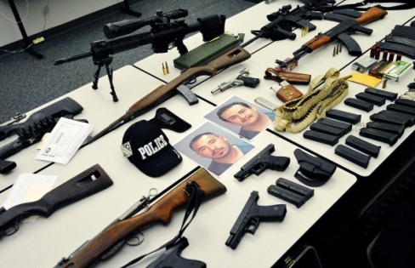
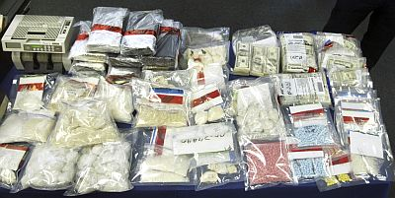
Then & Now…
Today gangs are much more violent… Why?
Drug Trafficking
Prostitution
Firearm Dealing

Slide 6
What does a Gang Member Look Like?
Majority Male
Mostly Minority
Estimated 1 million gang members in US (2008)

Slide 7
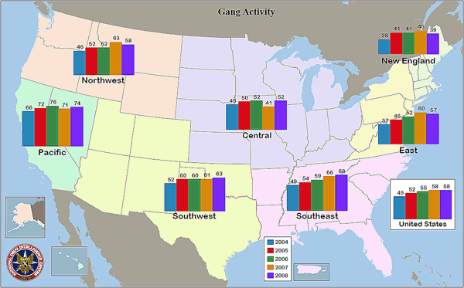
Percentage of State and Local Law Enforcement Agencies Reporting Gang Activity, by Region ~ Justice.gov

Slide 8
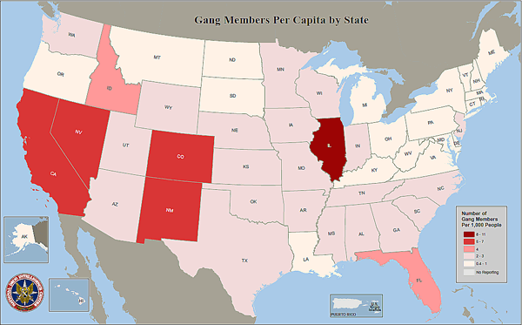

Slide 9
Why Do People Join Gangs
Family Members in a gang
Basic Needs unmet
Lure of Money

Slide 10
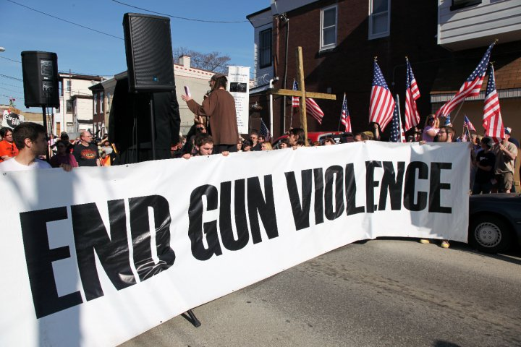
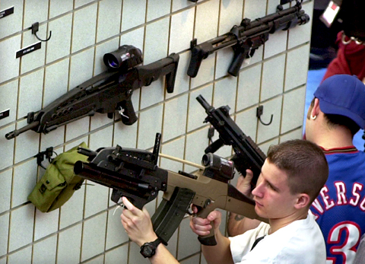
Guns and the Law

Slide 11
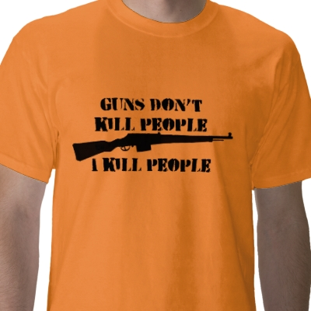
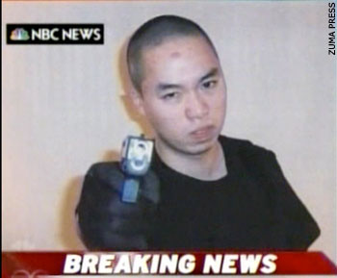
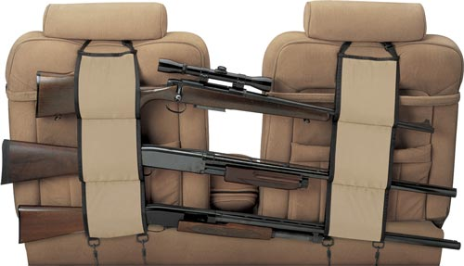
Do Guns=Crime?
Most guns are legally owned in the U.S.
Should gun right be restricted?

Slide 12
Important Legislation
Gun Control Act of 1968
Prohibits certain people from buying/possessing a gun
Criminals, minors, illegal immigrants
Requires serial numbers on all guns
Response to murders of Dr. King & Bobby Kennedy
The Brady Act
Requires background checks

Slide 13
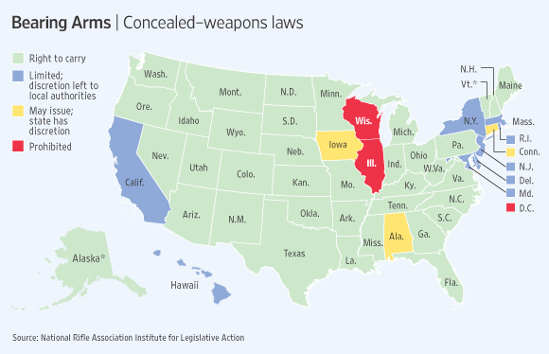
Wall Street Journal (2009)

Slide 14
