Slide 1
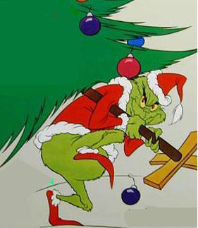
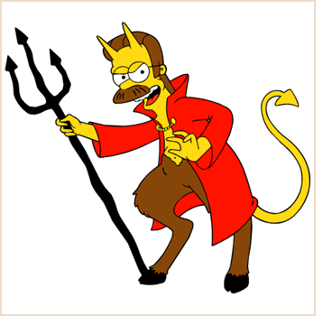
Deviance and Social Control
Chapter 7 Section 1

Slide 2
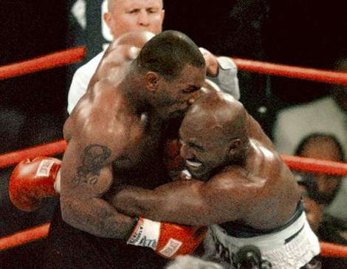
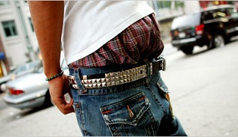
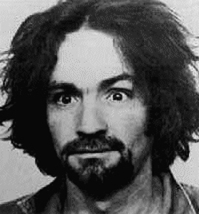
What is Deviance?
Behavior that departs from the norms of a group or society
Can include a broad range of behaviors:
Sagging pants
Not using a coaster
Murder

Slide 3
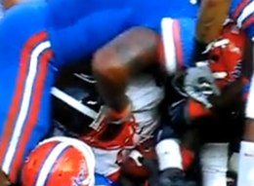
Negative Deviance
Behavior that fails to meet the accepted norms of society
Reject it
Misinterpret it
Unaware of it

Slide 4
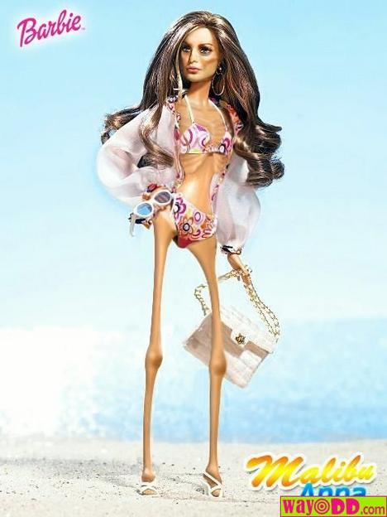
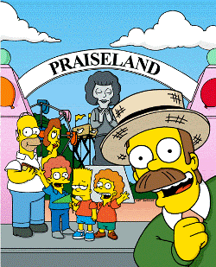
Positive Deviance
Behavior that over-conforms to social expectations

Slide 5
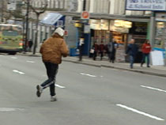
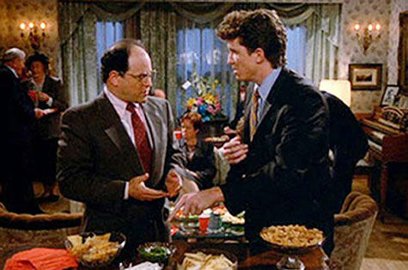
We All Break the Rules Once in a While
There are many degrees of deviance
Minor deviant acts occur on a regular basis in our society
Wearing mismatched socks
Wearing the same hoodie for two weeks straight
Are these people considered deviants?

Slide 6
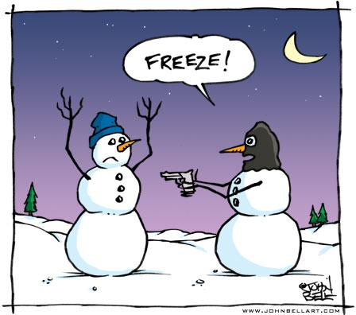
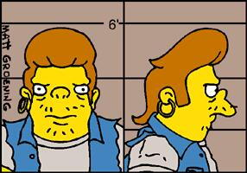
Deviant
Person who breaks significant societal or group norms
Drug Users
Child Molesters
Thieves

Slide 7
Social Control
Ways to encourage conformity to society’s norms
Two types:
Internal
external

Slide 8
Internal Social Control
Is up to the individual
“Knowing Right from Wrong”
Saying “thank you” when someone opens the door for you
Not stealing… because you know it’s wrong, not because you are afraid of going to jail

Slide 9
External Social Control
Decisions are made based on outside factors
Social Sanctions play a key part
Rewards or punishments to encourage conformity to norms
Can be formal and informal
Examples:
Jail, suspension, low grades, being ridiculed
Awards, good grades, high fives

