Slide 1
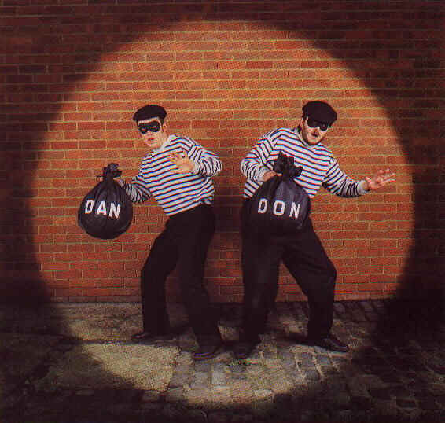
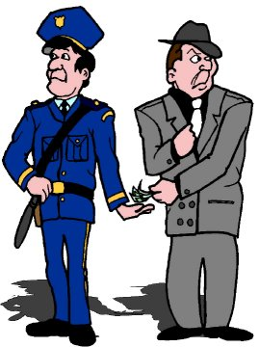
Functionalism and Deviance
Chapter 7 Section 2

Slide 2
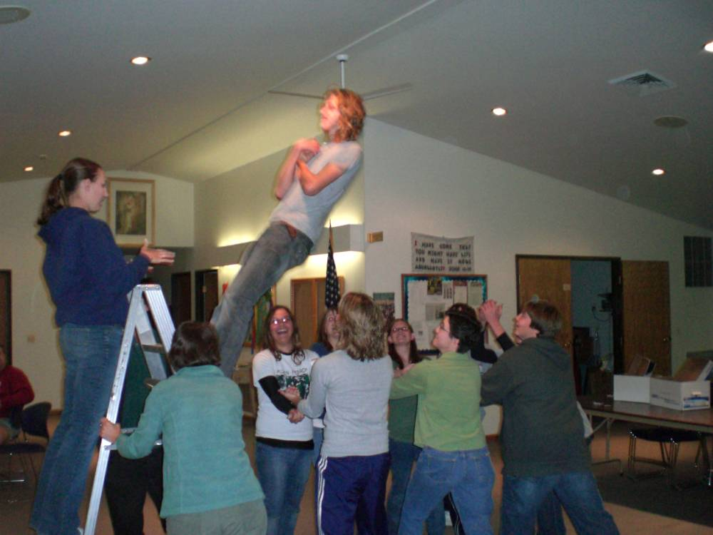
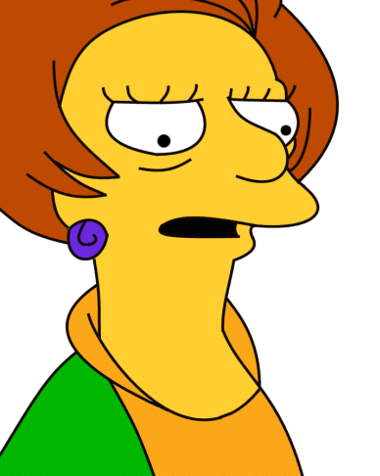
How Can Deviant Behavior Have a Negative Effect?
Deviance wears away trust
What if…
  People didn’t stop at stop signs?
  Parents do not consistently discipline their children?
  Teachers do not enforce all the rules?
I doesn’t matter to me if the students come in late to my class

Slide 3
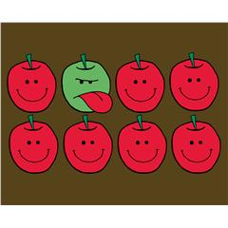

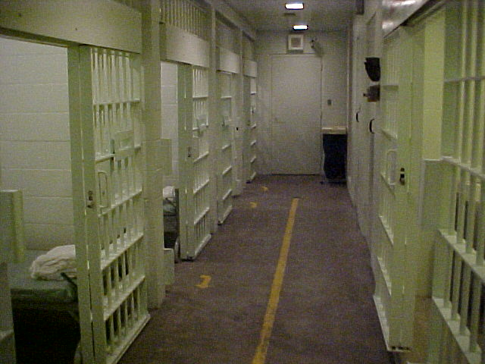
Negative Effects (cont.)
Deviance breeds more deviance, especially when unchecked
Leads to nonconformity
It is expensive!

Slide 4

It’s Not All Bad!
Deviance can be positive
How can nonconforming behavior be a positive?

Slide 5
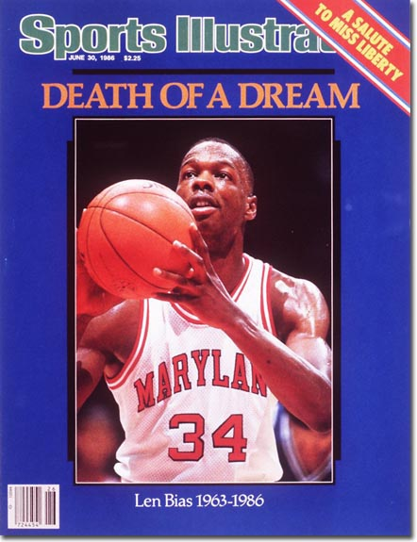
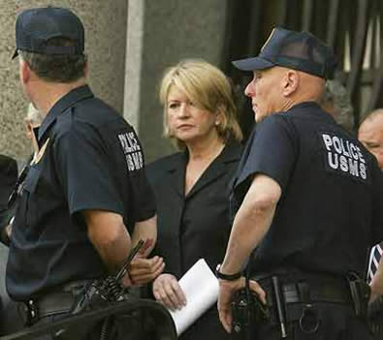
Can Clarify Norms
People receiving sanctions can serve as examples

Slide 6



Provides a Release
Minor deviant behavior can serve as avenue to release angst

Slide 7
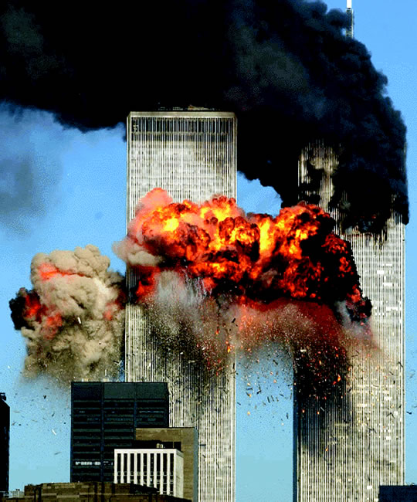
Increases Unity Within a Group or Society
Deviant behavior may reinforce norms and beliefs

Slide 8
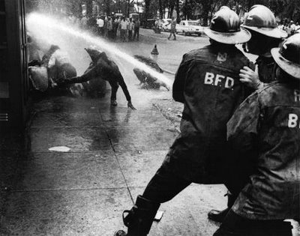
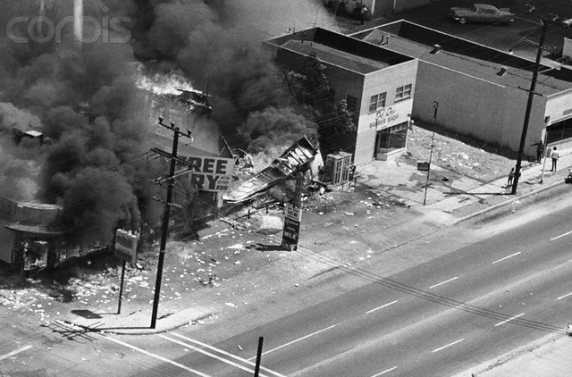
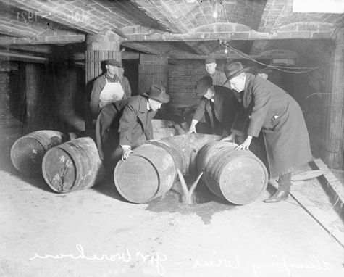
Promotes Social Change
Makes injustices known
Leads to changes in policies/laws

Slide 9


Strain Theory
Idea that deviance is more prone when a gap exists between cultural goals and the ability to achieve these goals by legitimate means
  Obtaining Wealth
    Acceptable means: becoming educated, working hard, “paying Dues”
    Unacceptable means: stealing, selling drugs, scamming people

Slide 10


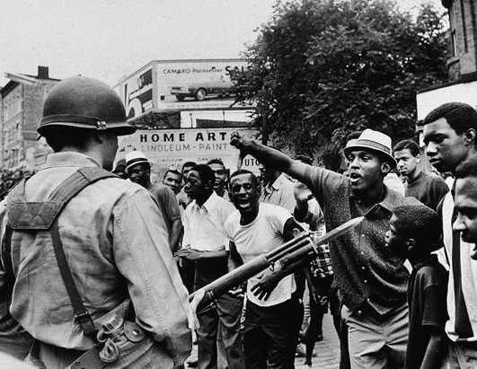
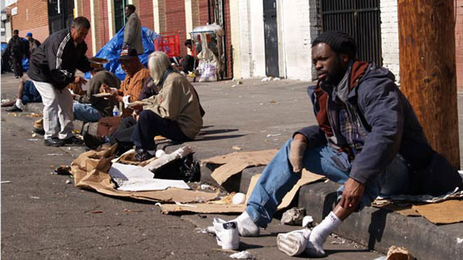
Responses to Strain
Innovation
Ritualism
Retreatism
Rebellion

Slide 11
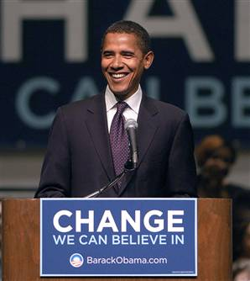
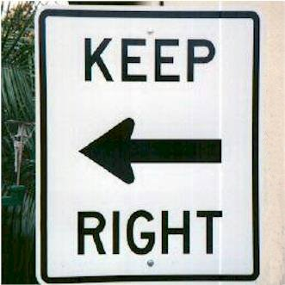
Control Theory
Theory that compliance with norms requires strong bonds between individuals and society
If bonds are weak due to anomie, deviance exists
Anomie: condition in which norms are weak, conflicting, or absent

Slide 12
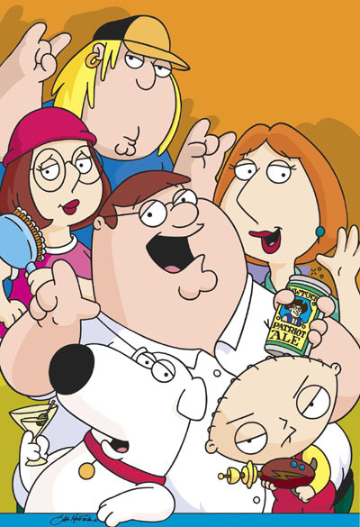
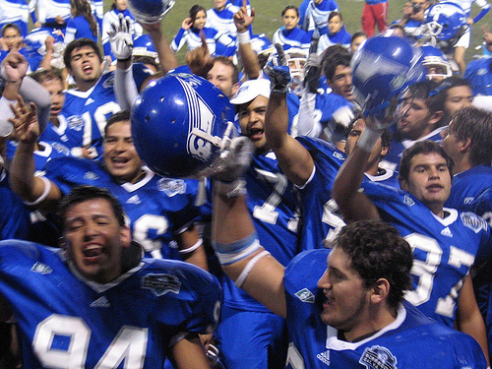
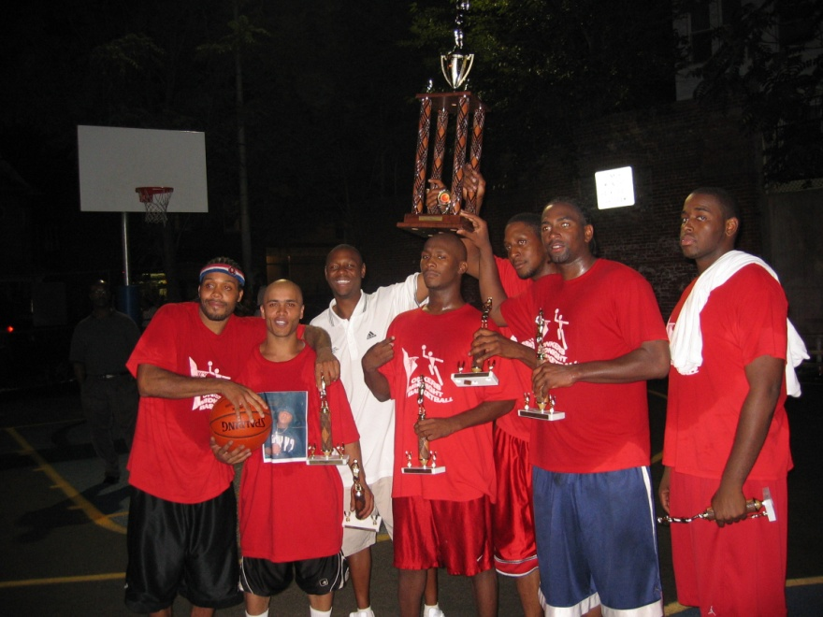

Elements of Social Bonds
Attachment
Commitment
Involvement
Belief

