Slide 1
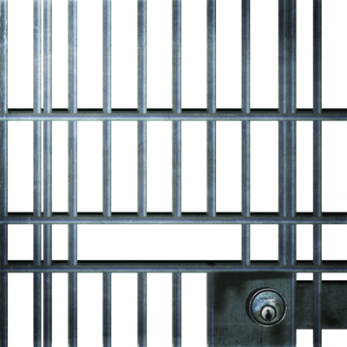
Symbolic Interactionism and Deviance
Chapter 7 Section 3

Slide 2
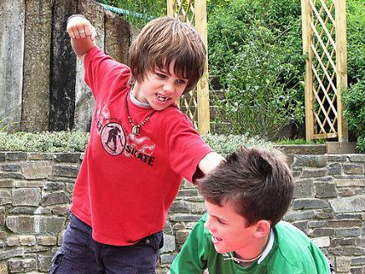
How Does It Explain Deviance?
Symbolic Interactionism believes that deviance is learned via socialization
Delinquent behavior is transferred to new individuals from previously existing groups

Slide 3
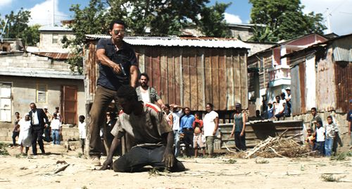
2 Ways of Learning Deviance
Differential Association Theory
Labeling Theory

Slide 4
Differential Association Theory
Individuals learn deviant behavior in proportion to the amount of deviant acts they are exposed to
Primary groups are key

Slide 5
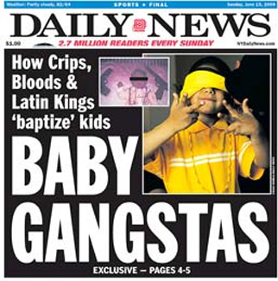
Differential Association Theory (cont.)
Three Characteristics
Ratio of deviant to nondeviant people
Whether deviant behavior is practiced by significant others
Age of exposure

Slide 6
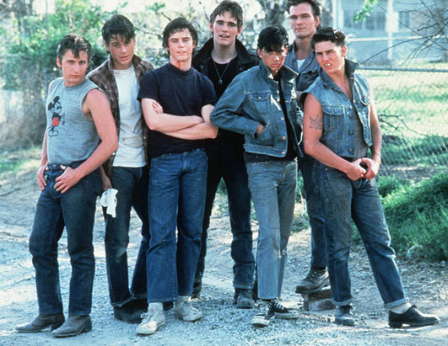
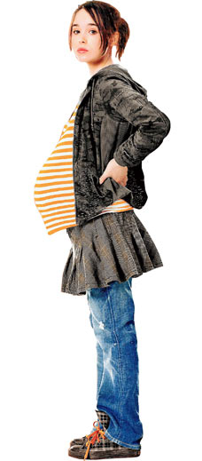
Labeling Theory
Theory that society creates deviance by identifying particular members as deviant
Boys vs. Girls
Acting out
Teenage Pregnancy

Slide 7
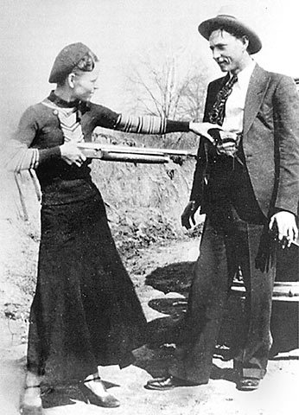
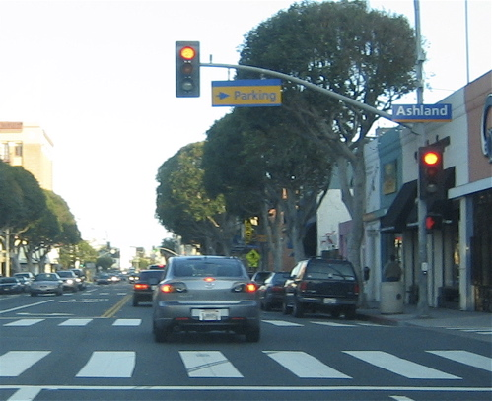
Degrees of Deviance
Primary
Secondary

Slide 8
Primary Deviance
Happens on occasion
Is not considered to be a part of their lifestyle or self-concept

Slide 9
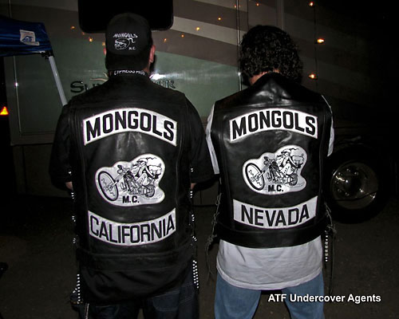
Secondary Deviance
When an individual’s life/identity is centered around breaking norms

Slide 10
Consequences of Labeling?
Creates Stigmas: undesirable traits used to characterize an individual
Can cause labeled individuals angst or suffering
Can determine the direction of their lives

