Slide 1
Conflict Theory & Deviance
Chapter 7 Section 4

Slide 2
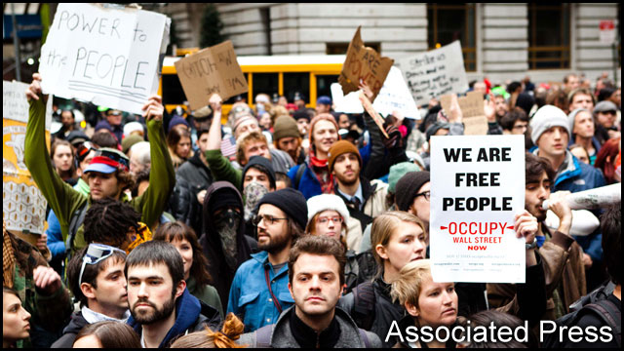
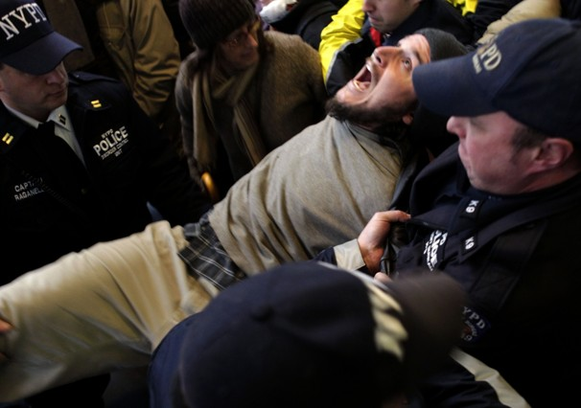
Deviance in an Industrial Society
Those in power see behavior that is a threat as deviant
Those in power maintain power by determining punishments

Slide 3
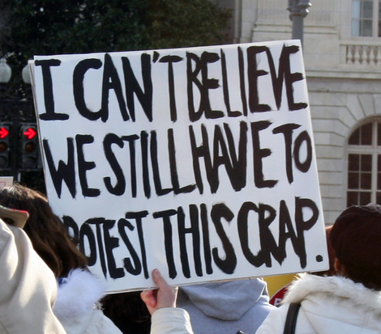
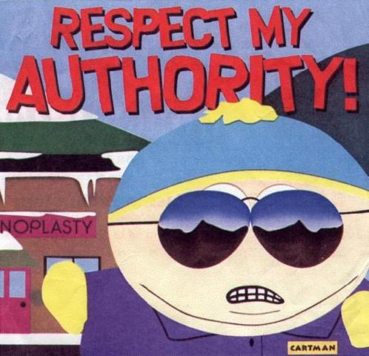
Defending Against Deviants
Criticism is deviant, challenges beliefs
Those who do not work are deviant
Do not threaten private property
Respect authority
Activities that emphasis values are encouraged

Slide 4
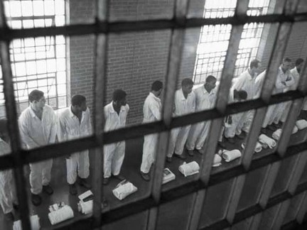
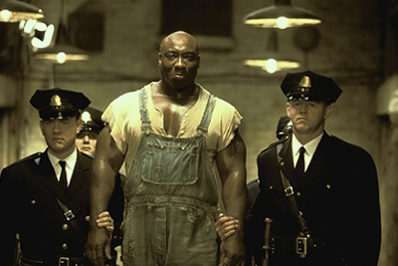
Unequal Treatment of Minorities
African Americans and Latinos receive harsher punishments, even for the same crimes

Slide 5
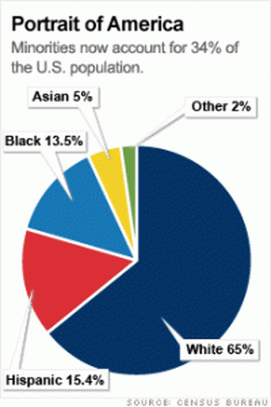
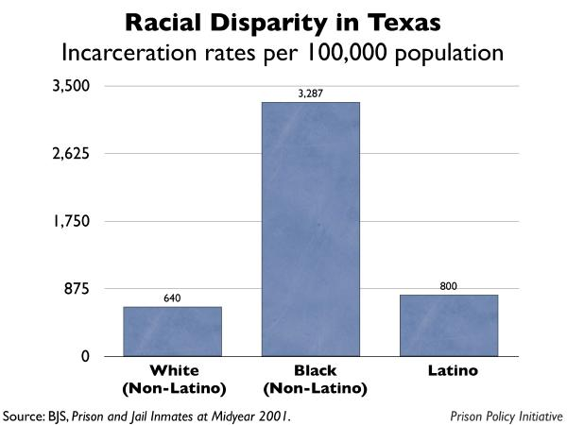
The Proof
African Americans
13% of population
42% of death row inmates

Slide 7
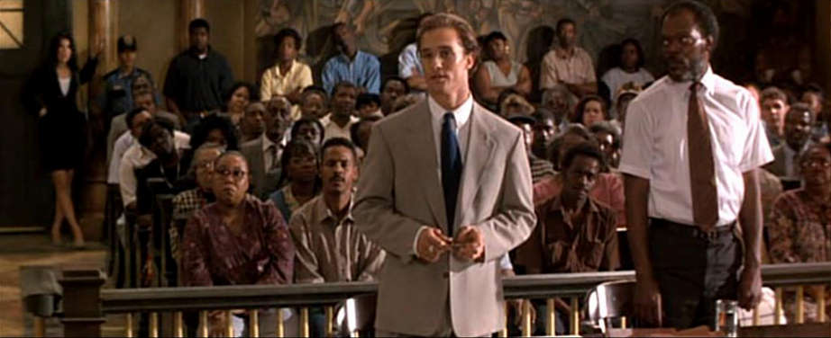
Why?
Lack of $ to hire attorneys
Victim Discounting

Slide 8
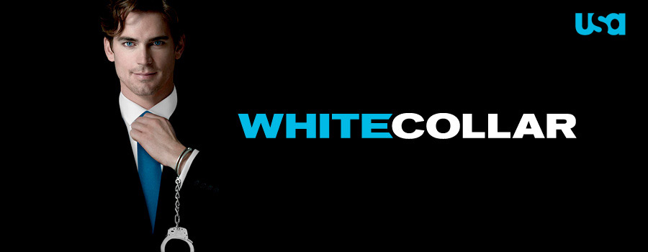
White-Collar Crime
Crime committed by well-respected, high-status people
Typically involves economic crimes
Embezzlement
Insider trading
Tax Evasion

Slide 9
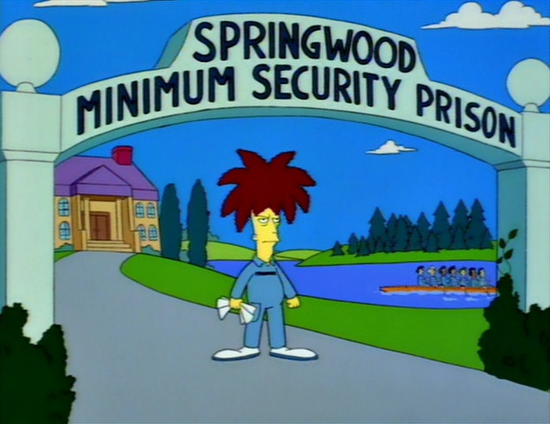
Slap on the Wrist
Most white-collar criminals are punished less severely
Probation
Shorter sentences
“resort” prisons

