Slide 1
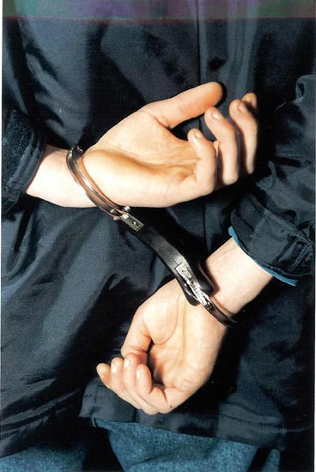
Crime and Punishment
Chapter 7 Section 5

Slide 2
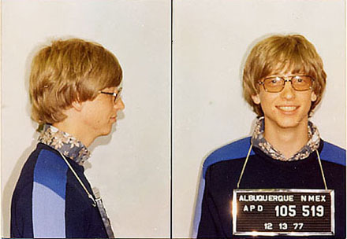

Crime
Any act that violates a statue of law
Wide Ranging
State and/or Federal

Slide 3
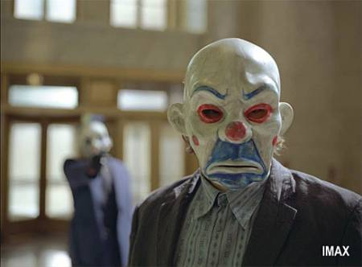
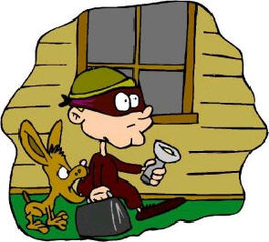
Crime in the U.S.
Most crimes are down, even though population is up
Burglary and larceny is up

Slide 4
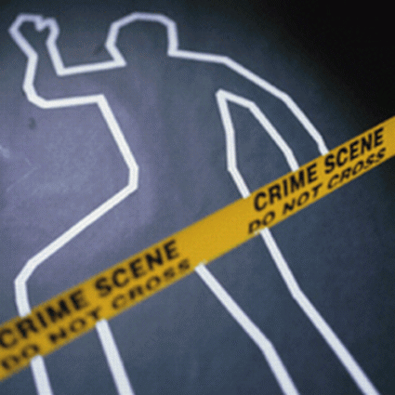
How do we collect crime stats?
Uniform Crime Reports (UCR)
Nine Categories
  Murder, rape, robbery, aggravated assault, burglary, larceny-theft, arson, hate crimes

Slide 5
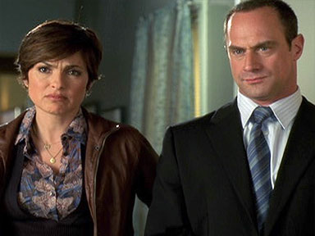
Problems with UCR
Over-represent lower class
Some crimes are not report
Some crimes are done in private

Slide 6
Juvenile Crime
Has gone down in recent years
Why?
  Lack of demand for crack-cocaine
  Others?

Slide 7
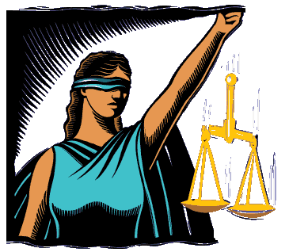
Criminal Justice System
System made of the institution and processes responsible for enforcing criminal statuses
4 Main Approaches
  Deterrence
  Retribution
  Incarceration
  Rehabilitation

Slide 8
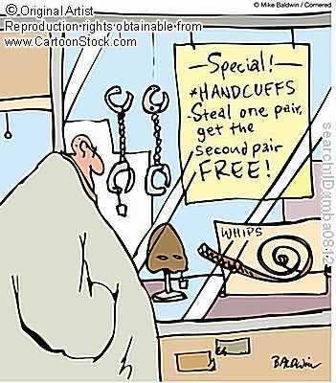
Deterrence
Discouraging criminal acts by threatening punishment
  Set examples
  Usually effective, but not with Capital Punishment
  Action needs to be quick

Slide 9
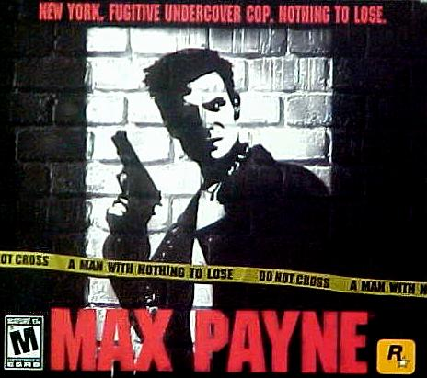
Retribution
Punishment that makes criminals pay for their actions
  Based on “eye for an eye”
  Taking the law into your own hands

Slide 10
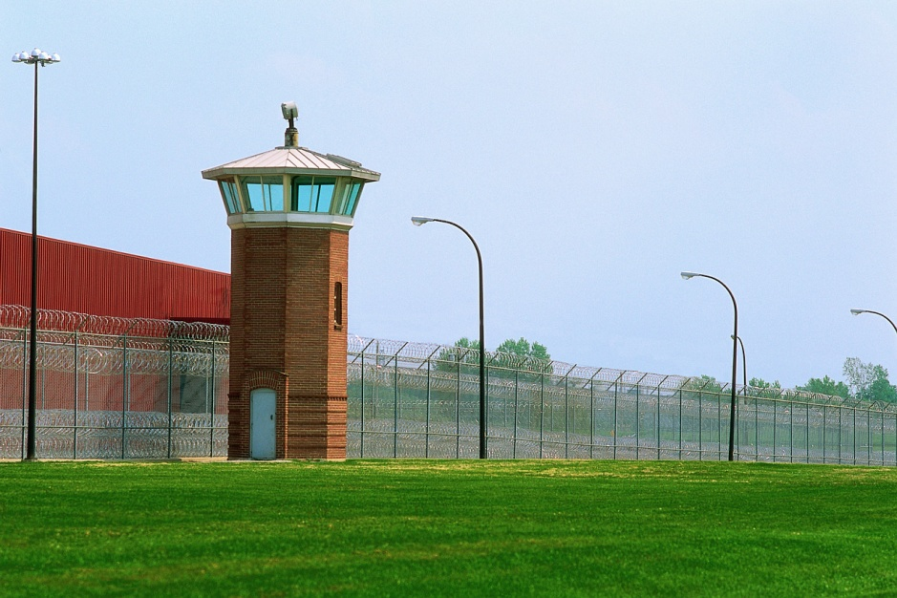
Incarceration
Method of protecting society from criminals by keeping them in prisons
Problems
  Overcrowding
  Three strike laws
Are criminals rehabilitated while in prison?

Slide 11
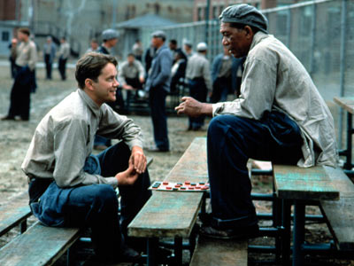
Rehabilitation
Process of changing or reforming a criminal through socialization
  Does this work in prison?
  Unfortunately, it does not. Most repeat criminal behavior

Slide 12
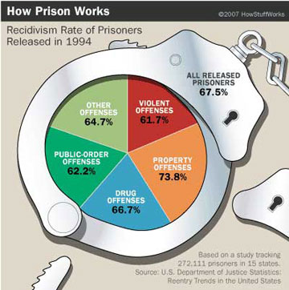
Recidivism
Repetition of criminal behavior
Reasons for high rate:
  Influences of other criminals
  Stigma about being an ex-convict

Slide 13

Possible Alternatives to Prison
Combination of prison and probation
Community-based programs
Diversion strategies
Will any of these work?

