Slide 1
Dimensions of Stratification
Chapter 8 Section 1

Slide 2
Social Stratification
Is the layers (strata) of people who own unequal shares of important resources
  Most important resources: income, wealth, power, and prestige
  Human tendency to form ranks

Slide 3
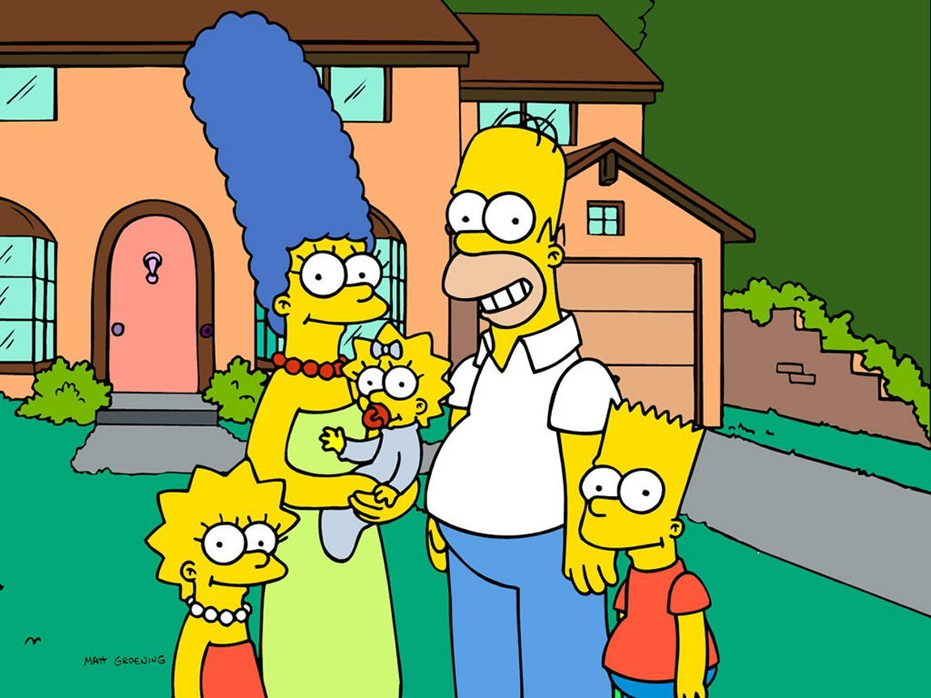
Stratification and Social Class
Each layer of the stratification system represents a social class
Social Class: segment of society whose members hold similar amounts or resources and share values, norms, and an identifiable lifestyle

Slide 4
American Society
Upper Class
Upper-Middle Class
Middle Class
Lower-Middle Class
Lower/Working Class
Poverty

Slide 5

Why are There Such Extremes in Classes?
Has to deal with issues of income vs. wealth
  Income: amount of money received by an individual or group over a specific period of time
  Wealth: total economic resources held by a person or group (what you own)

Slide 6
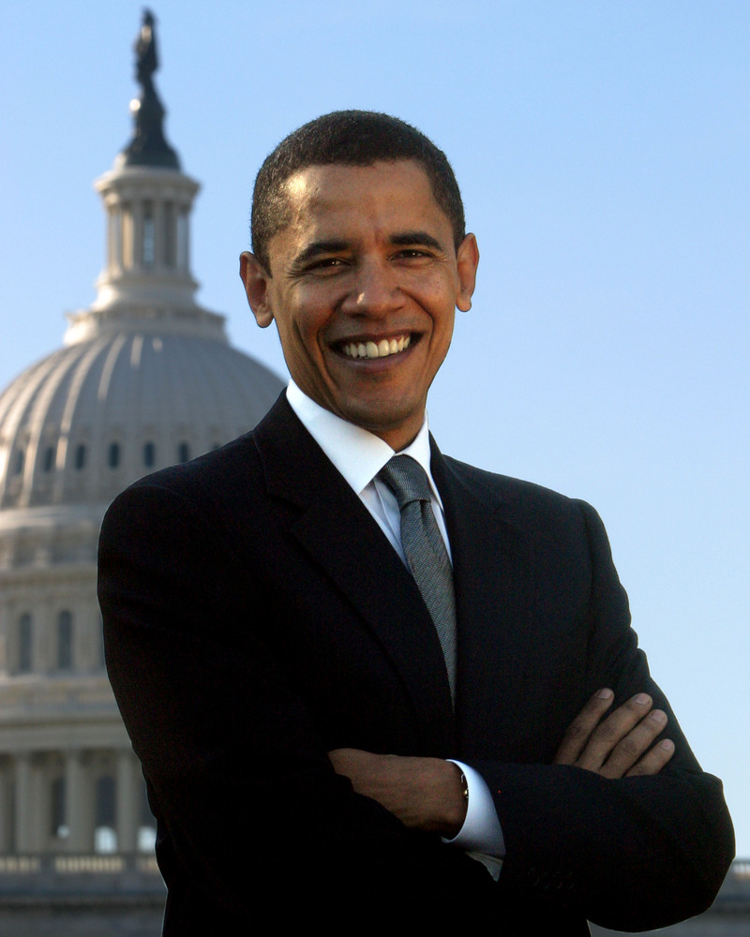

Power
Power: ability to control the behavior of others, even against their will
  According to Karl Marx, those who own and control capital have the power in society

Slide 7
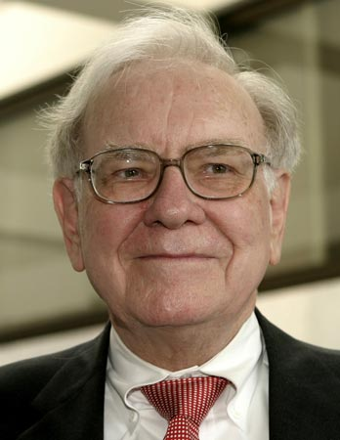
Power (CONT.)
Can include knowledge (inventions, expertise in a specific area, etc.)
Power can be attached to specific positions in our society
  Politicians
  Top executives

Slide 8

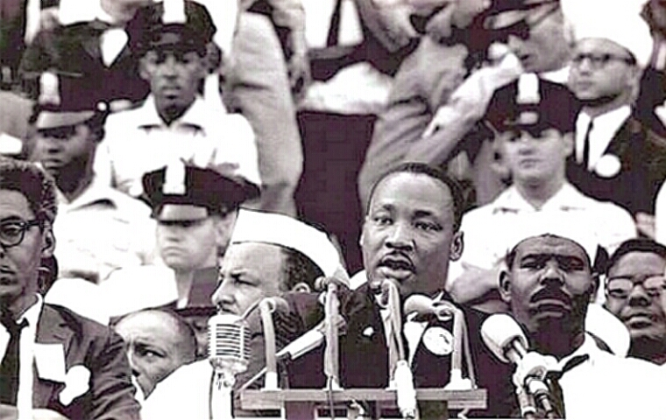
Power (CONT.)
Power can be obtained by having large numbers of people on your side

Slide 9


Prestige
Prestige: recognition, respect, and admiration attached to social positions
  Most often given to people based by occupation
  Can be recognized by groups that have power
    i.e. Purple Heart for military service
    Pulitzer Prize for journalists

