Slide 1
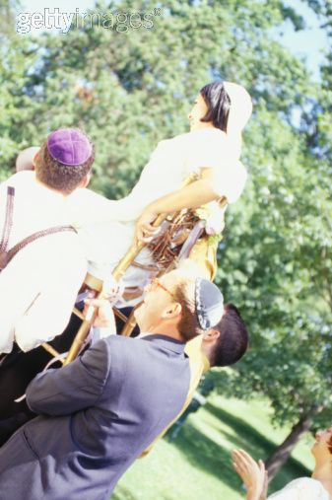
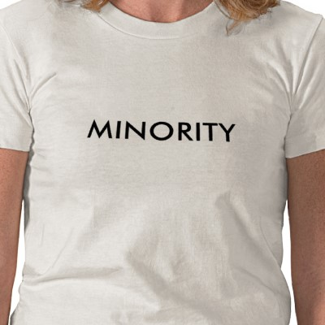
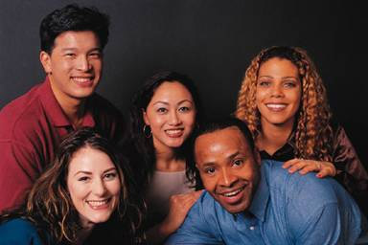
Minority, Race, and Ethnicity
Chapter 9 Section 1

Slide 2
Minority
Group of people with similar characteristics that are different from the dominant group in society
It is not as simple as a numbers game

Slide 3
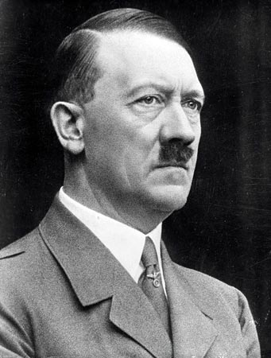
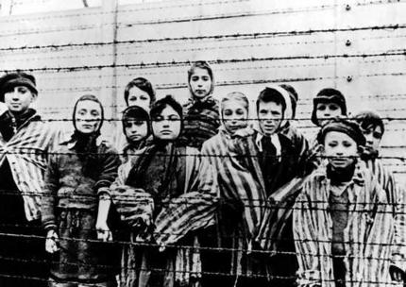
Characteristics of a Minority
Distinct physical or cultural traits that can be used to separate it from the majority
Majority dominates over the minority
Traits of the minority are believed to be inferior to the majority

Slide 4
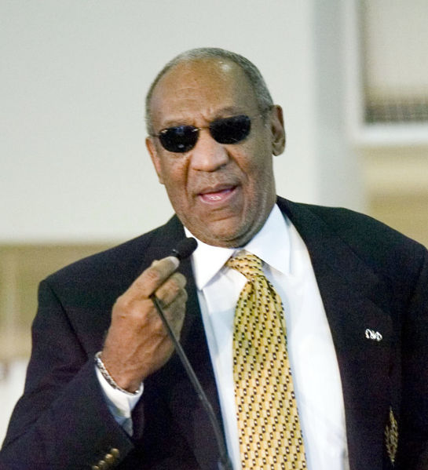
Characteristics Continued
Members have a sense of identity and group loyalty
The majority determines who belongs in the minority through ascribed status

Slide 5
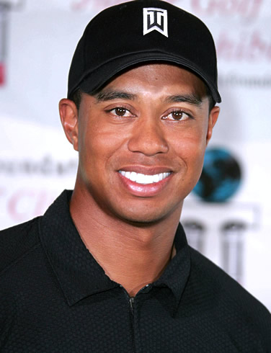
Race
People that share inherited biological traits (physical) that are considered important within a society
Eye/skin/hair color
Height/weight
Facial features

Slide 6
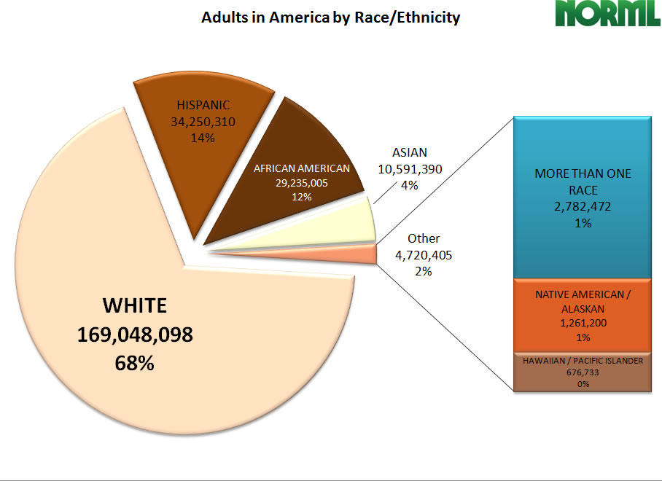

Slide 7
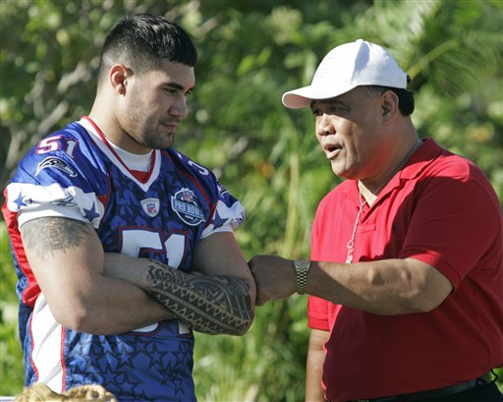
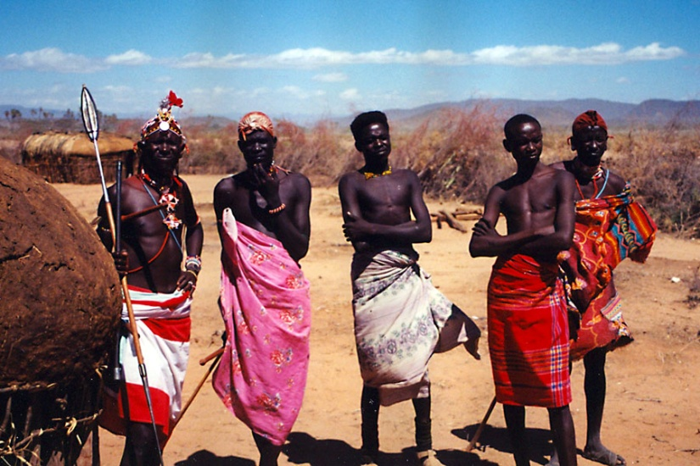
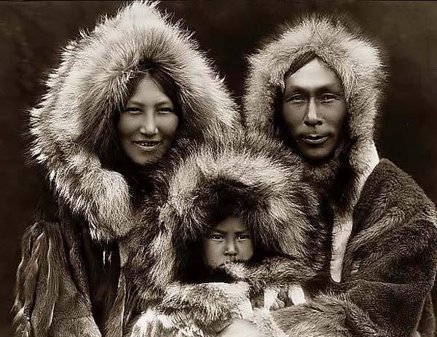
Do Physical Characteristics Make Someone Superior to Another
Yes…
But most characteristics provide an advantage to living in particular environments

Slide 8
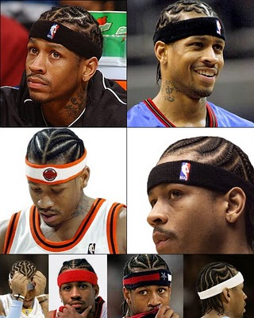
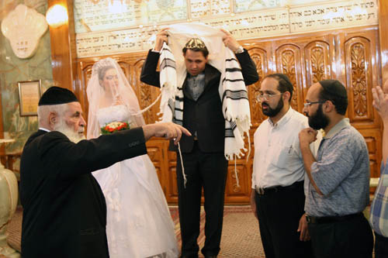
Ethnicity
Group identified by cultural, religious, or national characteristics
Share similar language, beliefs, values, norms
Many groups wish to maintain this separation

Slide 9
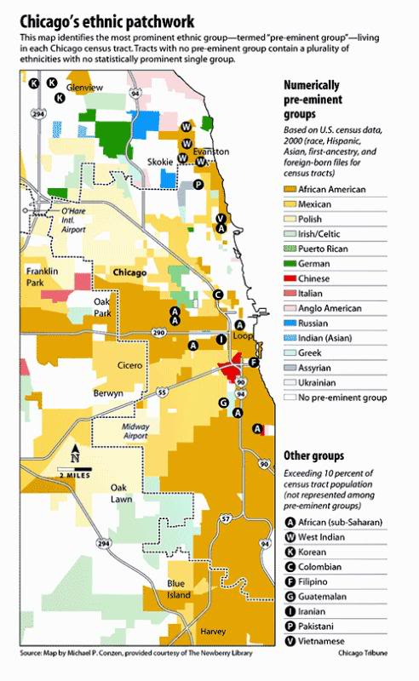

Slide 10
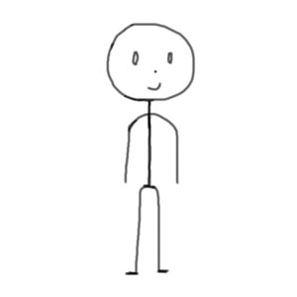
Ethnocentrism
Belief that one’s culture is superior or “the right” culture/way
Us vs. Them attitude
Those people are weird. That is not the right way to do that

