Slide 1
Theories of Prejudice and Discrimination
Chapter 9 Section 3

Slide 2
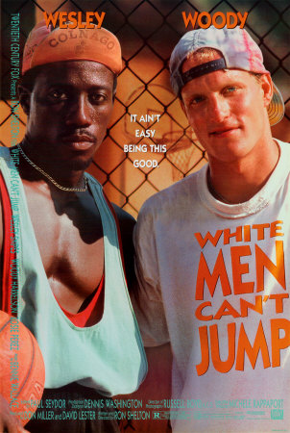
Prejudice
Widely held negative attitudes toward a group and its individual members
Can be both minority and majority

Slide 3
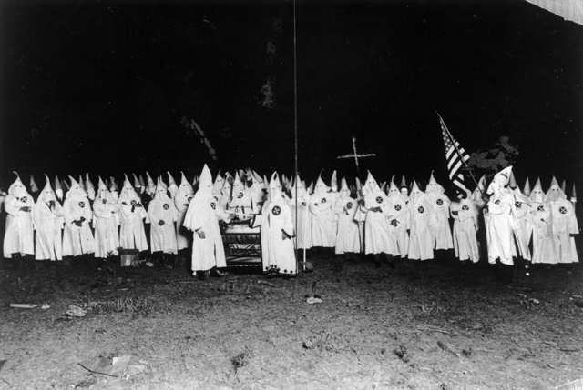
Racism
Extreme form of prejudice that assumes superiority of one group over others

Slide 4
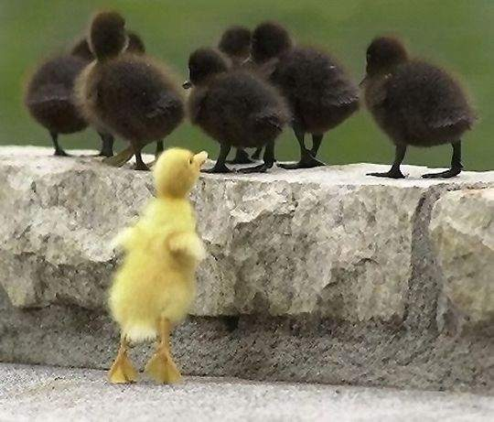
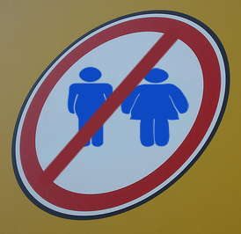
Discrimination
Treating people differently based on ethnicity, race, religion, or culture

Slide 5
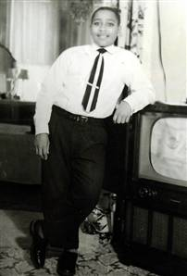
Hate Crimes
Are criminal acts motivated by prejudice

Slide 6
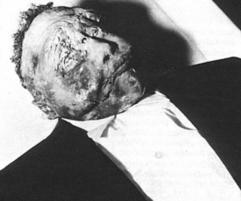

Slide 7
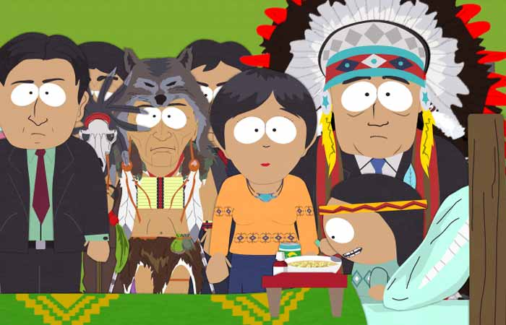
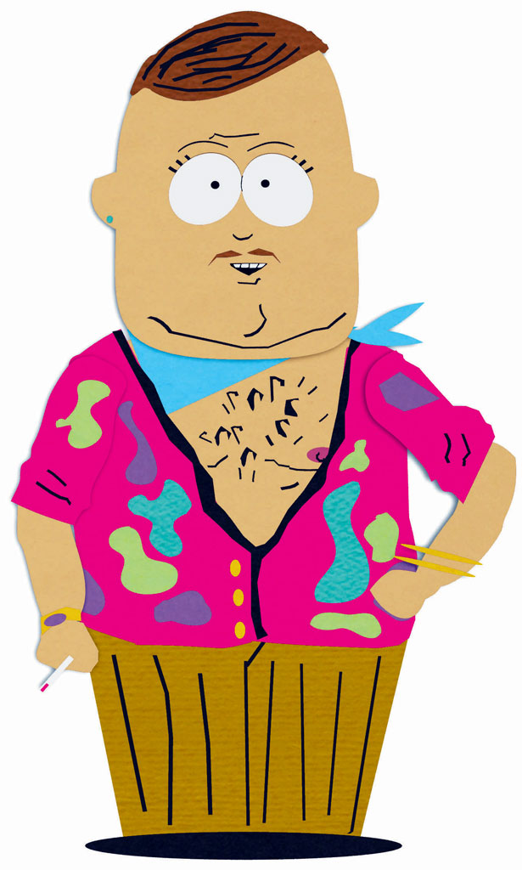
Stereotypes
Distorted, exaggeration, or oversimplified image applied to a category of people

Slide 8
Functionalist Perspective
Looks at the dysfunctions created by prejudice, racism, and discrimination
How does it impact the educational, political, economic, and social aspects?
Fosters feelings of superiority among the majority

Slide 9
Conflict Perspective
Majority uses prejudice, racism, and discrimination as tools to control minority
Minority groups tend to view each other as competitors instead of allies

Slide 10
Symbolic Interactionist Perspective
Prejudice, racism, and discrimination are learned in the same way one would learn to be patriotic
In every day language:
Blacklisted, Blackballed, Black mark, etc.

