Slide 1

Minority Groups in the United States
Chapter 9 Section 4

Slide 2
Institutionalized Discrimination
Type of discrimination that results from unfair practices that are part of the structure of society
  Have grown out of traditional and accepted behaviors

Slide 3


Public Education
It is a right that every American is entitled
“Some are just entitled to a better one”

Slide 4

Education (Continued)
Funding for education is based largely on property taxes
  Wealthier areas have higher taxes
  Poorer areas have much lower taxes
This causes a discrepancy in:
  Teacher training
  Quality of building and materials
  Age of textbooks

Slide 5
A Tale of Two Illinois Schools
East St. Louis High School
New Trier High School
$5,955 per Student
53% Of Students meet or exceeded PSAE Standards
Student Demographics
  98.2% Black
  1.6% Hispanic
  0.1% White
$ 10,265 per Student
88% of Students meet or exceeded PSAE Standards
Student Demographics
  86% White
  8% Asian
  0.6% Black

Slide 6
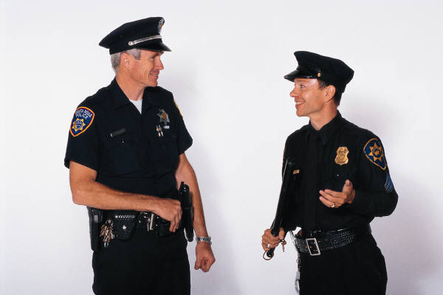
Police and Government Officials
In the past, minorities were not “allowed” in these positions
Many families have been following in each others footsteps

Slide 7
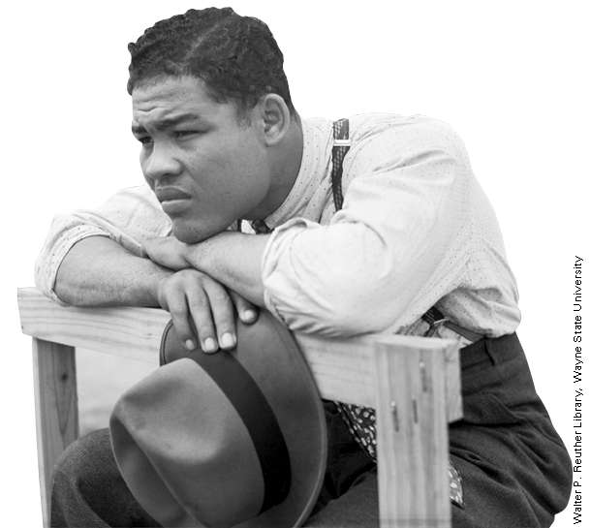
African Americans
Now the second largest minority group
Barriers to assimilation
  Skin color is an easily identifiable characteristic
  History of the U.S.

Slide 8
African-Americans (Cont.)
Average income levels for African-Americans
  For every $100 a white individual makes, an African-American makes $62 (1999)
  Differences in net wealth (homes, business, cars, etc.)

Slide 9
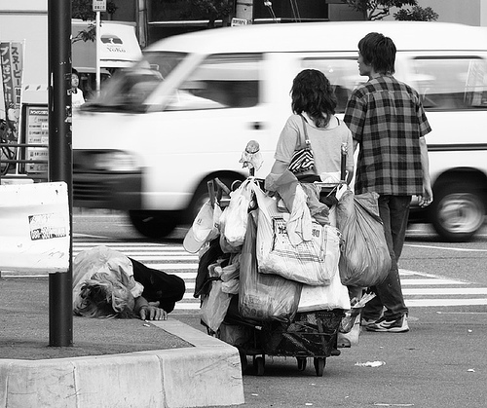
Hidden Unemployment
Unemployment that includes people not counted in the traditional unemployment categories
  People who have stopped looking for work
  Part-time workers

Slide 10
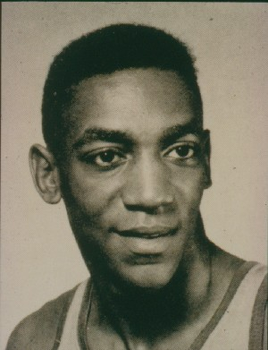
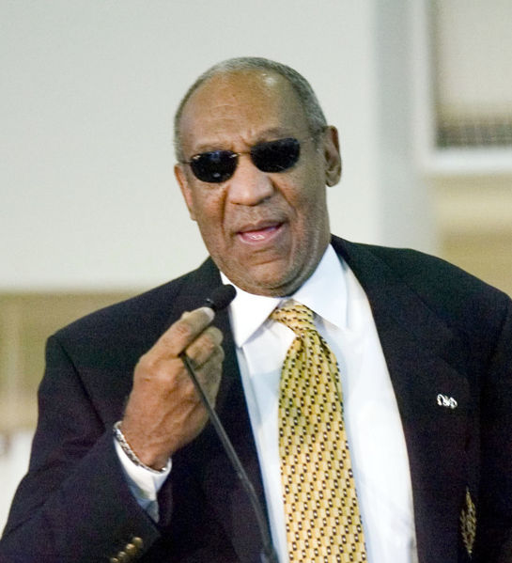
Advances made by African-Americans
Education is the key
# of professionals has increased dramatically

Slide 11
Advances made by African-Americans (Cont.)
Predictions
  Black middle-class will increase
  Underclass will increase as well
Underclass: people typically unemployed who come from families that have been poor for generations

Slide 12
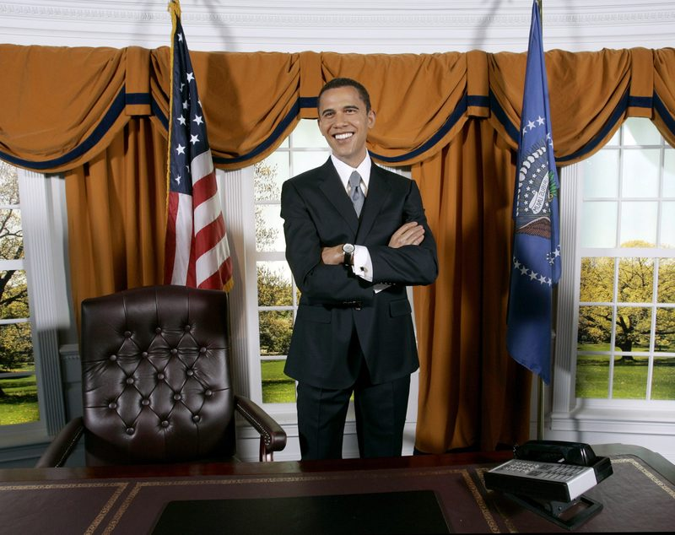
Advances made by African-Americans

Slide 13
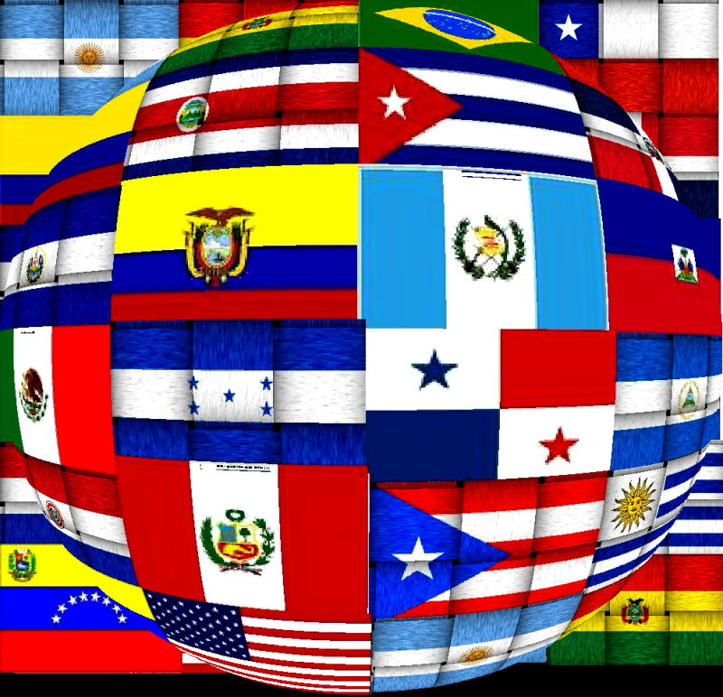
Latinos/Hispanics
Now the largest minority
Various differences due to large # of countries/backgrounds

Slide 14
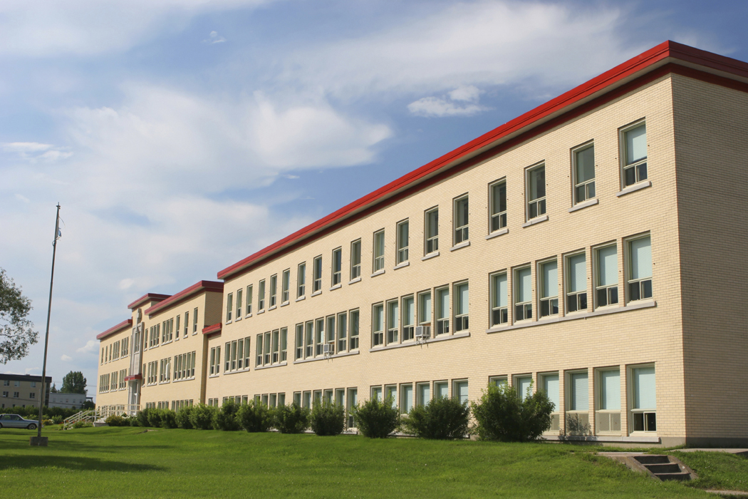
Latinos/Hispanics (Cont.)
Do not usually obtain high levels of education
25% live below the poverty line

Slide 15
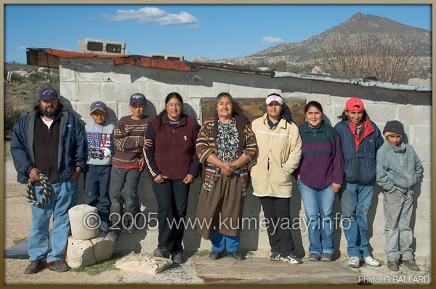
Native Americans
Less than 1% of population
Lowest annual income of any minority
Those living on reservations is considerably worse

Slide 16

Asian Americans
4% of the population
Come from a variety of backgrounds/countries
Education is very important
High rate entering into professional fields
Highest income among immigrants

