Slide 1
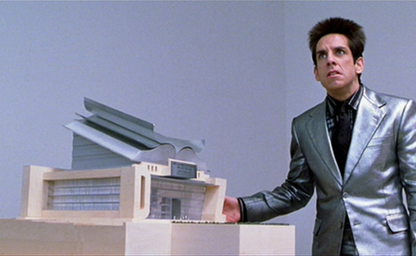
Welcome to Mr. Johnson’s Learnatorium
A Guide to the Expectations and Rules of Class

Slide 2

How to take notes
Date
Heading
        NOTES

Slide 3
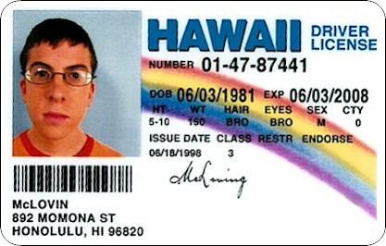
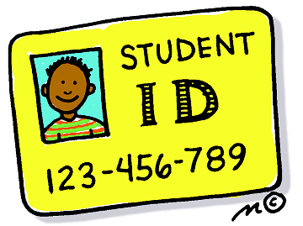
ID’S
You MUST have an ID to enter class
It MUST be worn properly around your neck and visible
It MUST be your ID
Get your ID’s OUT, ON, and VISIBLE

Slide 4
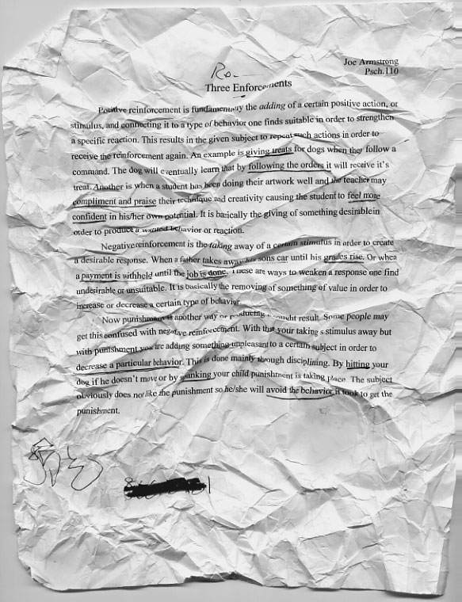
Homework/Assignments
Any assignment that is not turned in when it is collected IS LATE!!!!
Assignments turned in late will receive partial credit (75%)
Late assignments must be turned in 2 DAYS after original due date to receive any points
Any Make-up work from suspension or an unexcused absence is worth a maximum of 75%
Sloppy assignments will NOT be accepted!!!

Slide 5
Earning a Late Work Pass
While students only have to days to turn in late work, you can earn a “Late Work Pass”
How: Come to CP and stay the entire period
Why: Allows a student to turn in one assignment that has expired

Slide 6
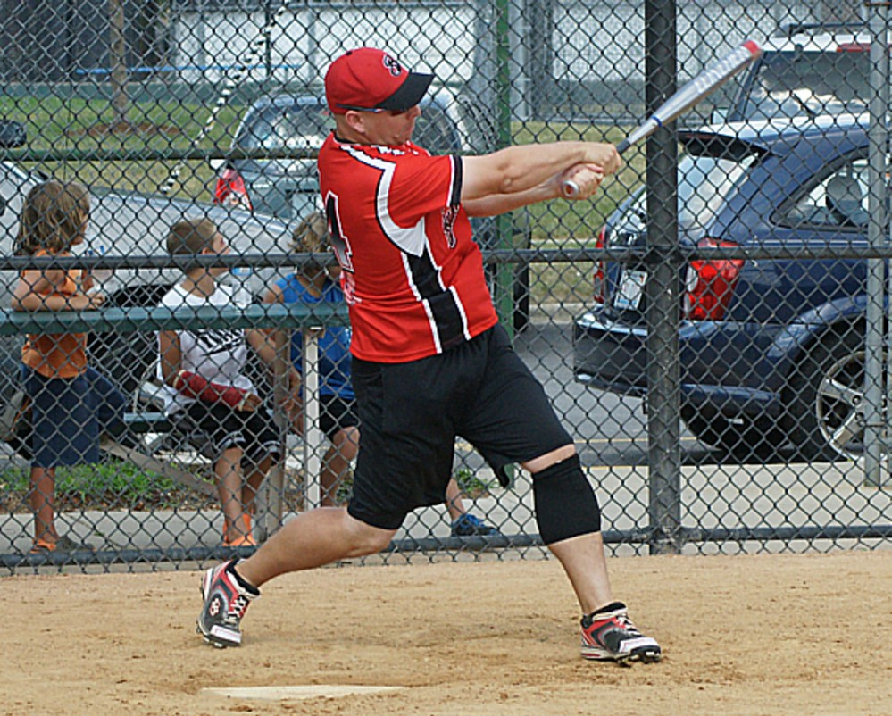
The 411 on Mr. Johnson
Classroom: B211
Email: johnson.scott@district205.net
Phone: (708)271-4680

Slide 7

How to get to the class website
Go to mrjohnsontr.weebly.com
OR…
Go to: www.district205.net
Select Thornridge at the top left
Go to “Areas for Instruction” and select Social Studies
Click where it say Mr. Johnson

Slide 8

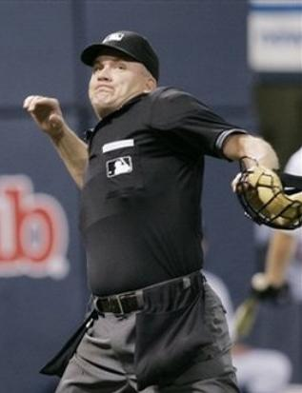
Classroom Rules
I enforce ALL school rules and policies!
Unfortunately, many students do not believe me at first. Here are some reminders!
Consequences will reflect the severity on the action!
  Phone call home
  CP Detention
  Sent to Dean

Slide 9

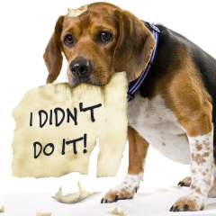
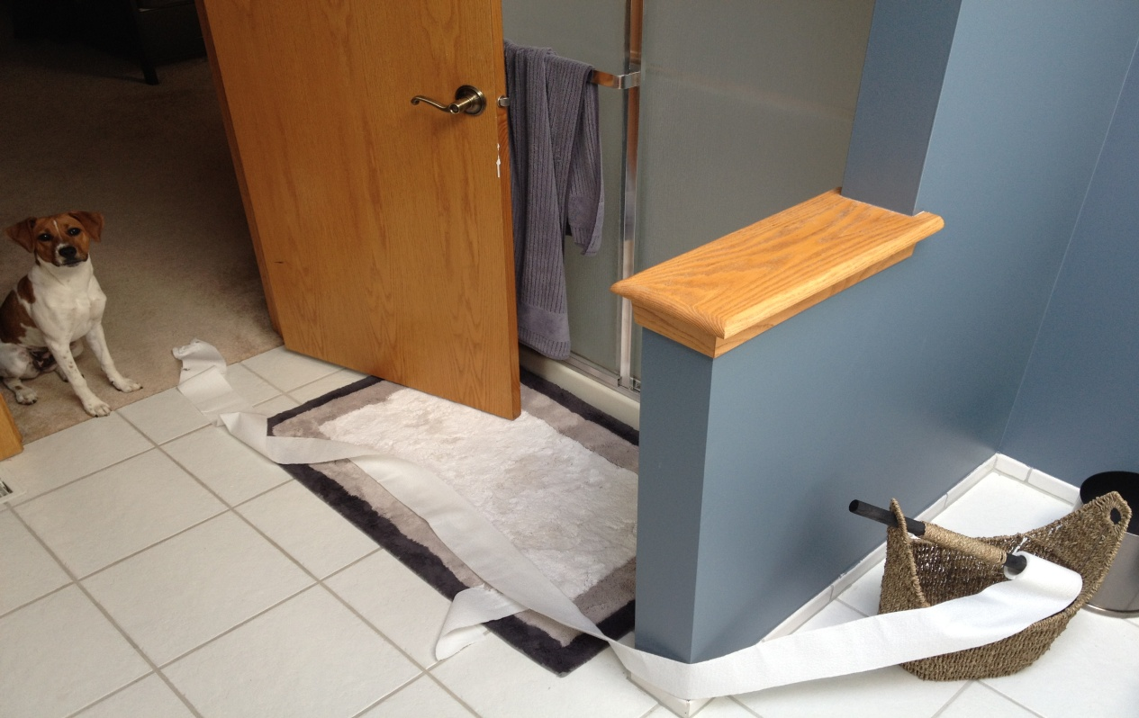
The 3 R’s
Respect Others
Respect Yourself
Responsibility for YOUR ACTIONS!

Slide 10
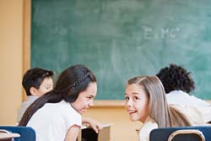
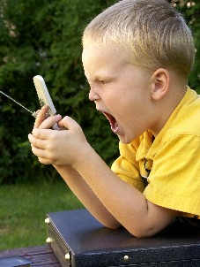
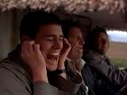
Talking
Talking while someone else is speaking is rude! So DON’T DO IT!!!
Talking/Texting on your cell phone is a no-no, even if it is your mom.
Remember to use your “Indoor Voice”

Slide 11
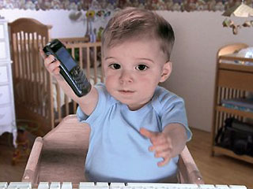
Cell Phones
Should be off and out of sight
I DO confiscate cell phones and will give them to your dean at my convenience.
  FYI- Which could be the next day

Slide 12

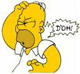


Please put away cell phones & electronic devices!
Confiscated cell phones/devices will be sent to your dean as per the school rules!
Politely give your phone to a staff member if asked. Refusal to do so will result in an anecdotal or referral to your dean. Don’t make things worse for yourself!!!
I thank you for your cooperation!

Slide 13
Personal Communications Equipment/Electronic Devices
Students are discouraged from bringing personal communication/electronic devices to school. The school takes no responsibility for the loss, breakage, theft, or any other harm to such devices while at school. Students are permitted to possess personal communication equipment/electronic devices while on school property. However, these devices must be turned off and stored out of sight during the school day. Use of such devices is permitted only before or after school hours while outside of the building.

Slide 14
What Happens to my Phone?
1st Offense
Dean confiscates and secures personal communications/electronic device and returns at the end of the day pending parent/guardian contact. Dean documents the offense.
2nd Offense
4-Hour Saturday detention is issued Parent/Guardian must pick up the communications/electronic device .
3rd Offense and subsequent offense
1-3 day suspension pending parent/guardian conference Communications/electronic device is returned to parent at the parent conference.

Slide 15
Excuses are unacceptable!
Be Prepared!
EACH DAY YOU NEED: A pen or pencil, notebook/paper, a folder, and your textbook.
“But I was coming from gym and supposed to get out earlier”
“I was supposed to go to my locker but there was a fight/my boyfriend/girlfriend/etc.”
“I was supposed to go to the store yesterday and buy more pencils/pens/paper.”
THIS IS UNACCEPTABLE!
TAKE RESPONSIBILITY FOR YOURSELF.

Slide 16
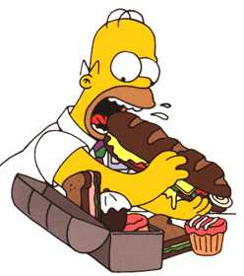
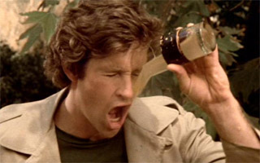
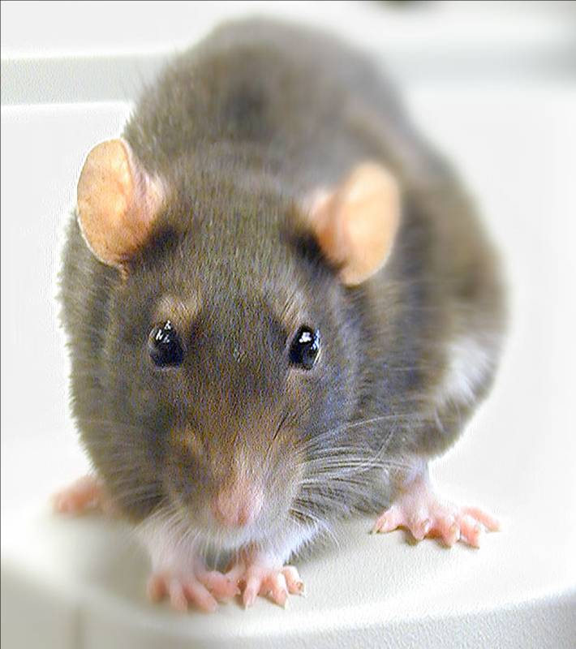
No Food or Drink!

Slide 17
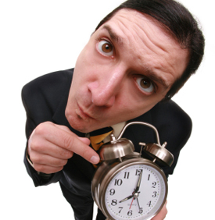

Tardy/Unexcused Absences
TARDY
Door will be shut when bell rings
1st & 2nd = warning
3rd = Afterschool Detention
4th = 2-hr Saturday
5th = 4-hr Saturday
6⁺= Suspension!!!!
ABSCENCES
1st= Afterschool Detention
2nd= 2-hr Saturday
3rd= 4-hr Saturday
4+= Suspension!!!

Slide 18

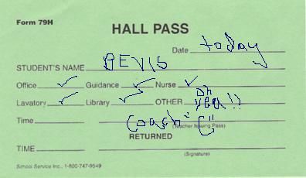
Pass Policy
I RARELY ever give out passes, so it is in your best interest to just not ask.
If you do not have your passbook, you will not be given a pass

Slide 19

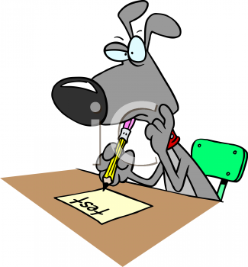
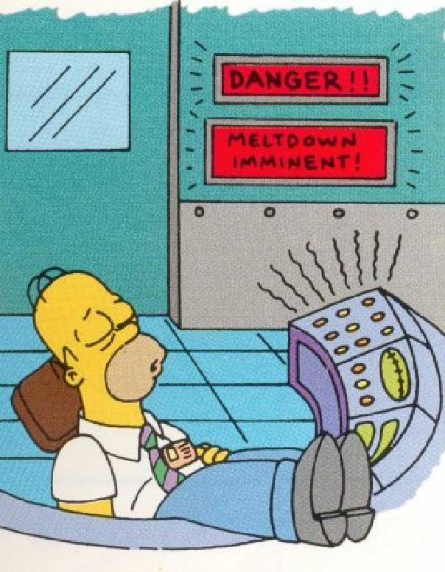
Testing Days
Bring a pencil
Failure to bring a pencil will decrease your test/quiz grade by 10%
It is not ok to talk while testing is taking place!
After you are finished, you may do work, sleep, or stare at the clock… there is NO talking until I inform the class it is ok
“Talking is cheating, cheating is cheating”
Cheating= ZERO

Slide 20

We calmly and quietly go out the door to the right.
Proceed down the stairs and out the door.
Walk down the sidewalk towards Sibley, about ¼ to the street.
Stand the left of the sidewalk.
Check back in for attendance.
We stay together as a class.
If I am absent, you check in with B212, and stay with that teacher! (Bring the sub with you)

Slide 21
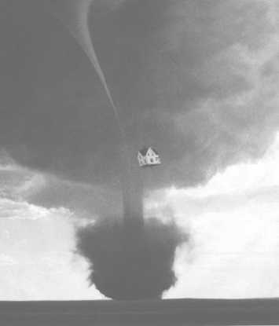
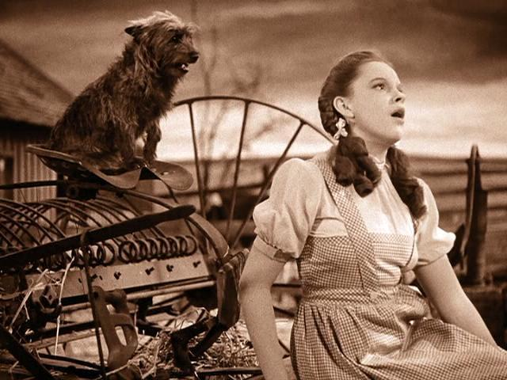
Tornado Drill
UH OH Toto, It’s a Twister, It’s a Twister. We better go tell Auntie Em
Calmly & quietly walk out the door and go right
Walk down the stairs and go down the B1 Hallway
Find a place down the hall and remain quiet for the duration

Slide 22
Movie Time
http://www.youtube.com/watch?v=Ipuy-EMcesE

Slide 23
Story Time!
"Everybody, Somebody, Anybody, And Nobody"
This is a little story about four people named Everybody, Somebody, Anybody, and Nobody.
There was an important job to be done and Everybody was sure that Somebody would do it.
Anybody could have done it, but Nobody did it.
Somebody got angry about that because it was Everybody's job.
Everybody thought that Anybody could do it, but Nobody realized that Everybody wouldn't do it.
It ended up that Everybody blamed Somebody when Nobody did what Anybody could have done

